Slide 1
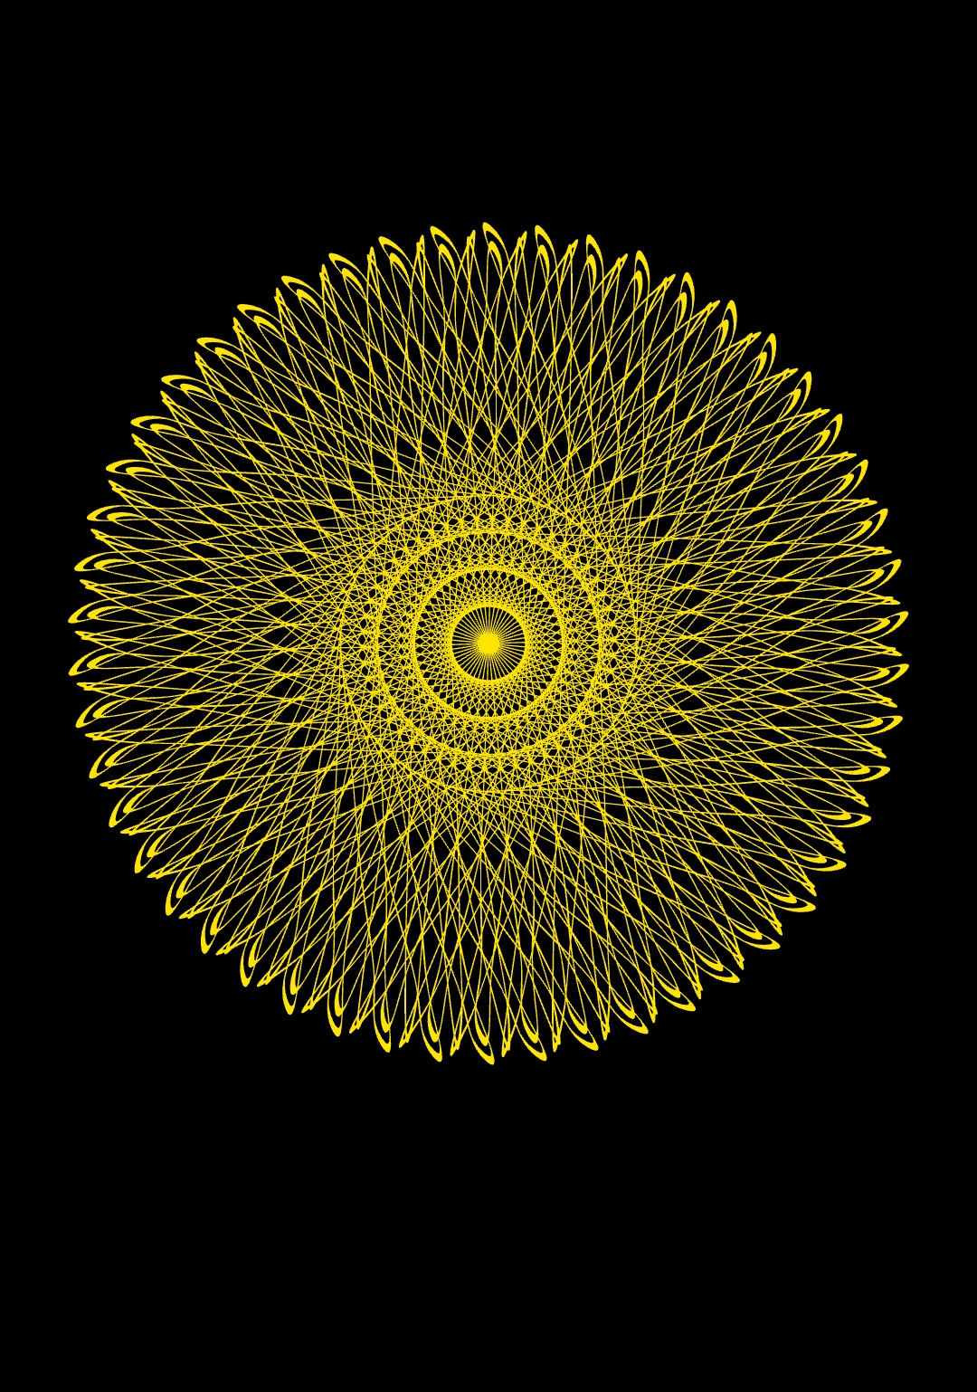
P1/7
<Computational Design Thinking>
<Generative Design>
P1/7
BEST PICTURE
Assignment
Context
Course
Date
Generative
Design
Freshmore
Term 1
Computational
Design Thinking
2021
Student
<Theme>
Darren Chan Yu Hao
1006340
Small Changes
< Description >
The objective of this project was to create a design that was beyond we, humans, can manually create.
Our world is always uncertain, some might even say it is chaotic. One tweak in a single action, and the outcome may become completely different.
It was challenging to think of a way to produce a result for such an idea. But it does not have to be complex, as one tweak can change the outcome entirely.
My final designs utilizes only just the manipulations of sine waves.
Instructor
Jason Lim
Instructor

Slide 2
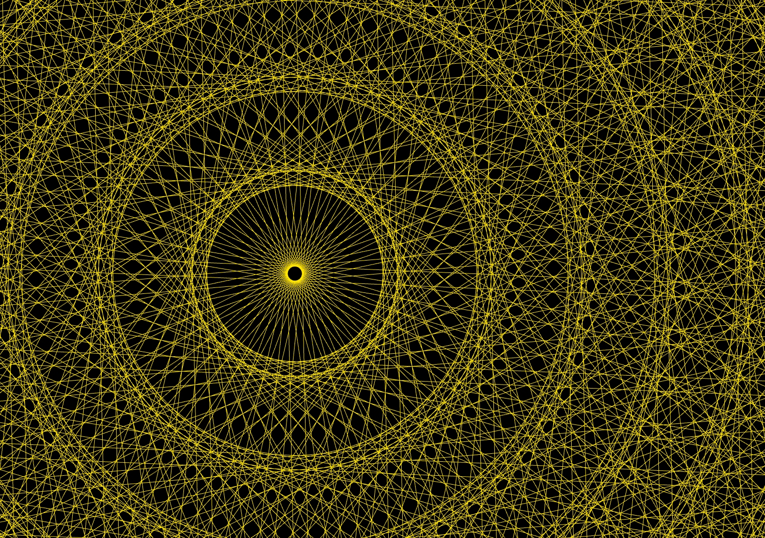
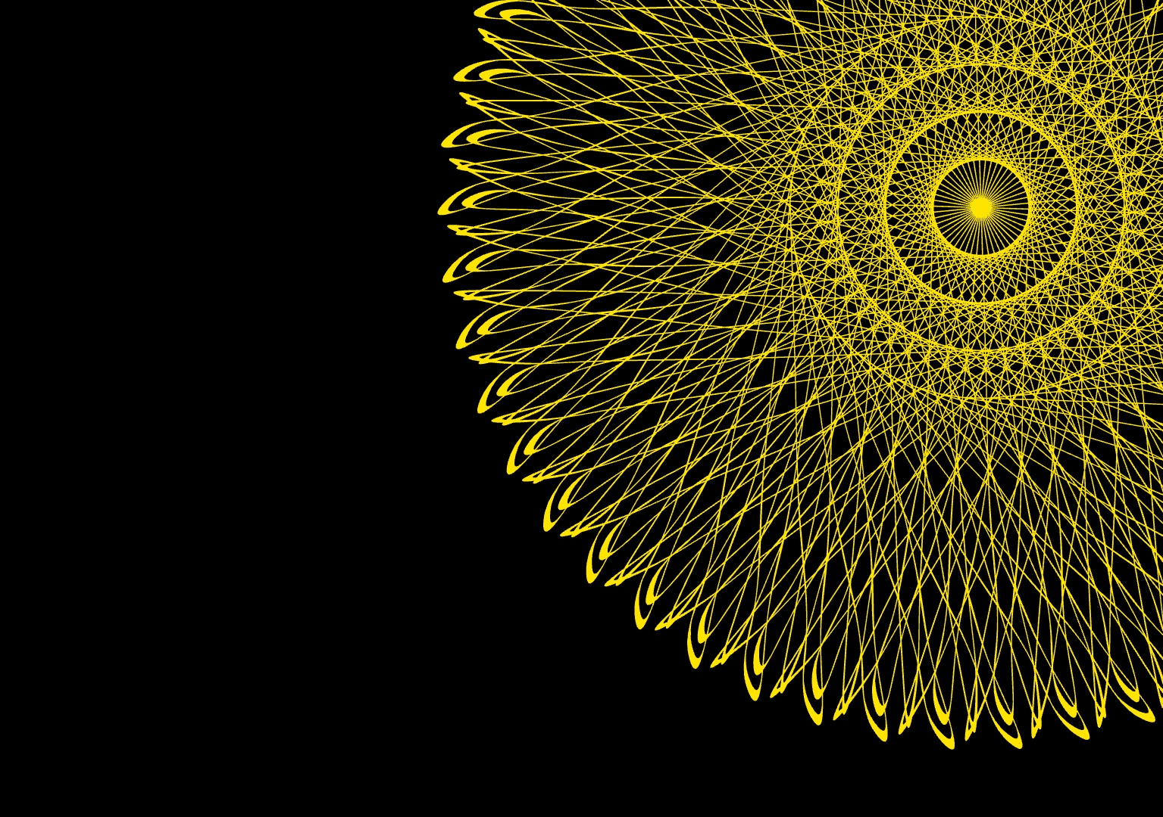
P2/7
<Computational Design Thinking>
<Generative Design>
P2/7
<Bloom>
The first design chosen and shown on the very main page looks sort of like a flower blooming in the cosmic emptiness.
It was partially inspired by the desire to create something out of nothing. Wanting something to burst into existences
In the following page, a video have been linked to showcase this blooming. The pictures on the left, taken at every 20 frames, are the different stages of the blooming. This blooming was created by varying just the amplitude of the sine waves.
Initially, it looks like normal sine waves coming out from an origin. But as the amplitude gets larger and larger, the sine waves intersect with each other in such a pattern that creates a sort of flower as shown.
When we finally zoom back into the final form of flower, the center has already mold into a seemingly complex, yet symmetrical intersection.
1/2
1/2
Captions
01 Zoomed in view of the center off Bloom
02 Offset view of Bloom
01
02

Slide 3

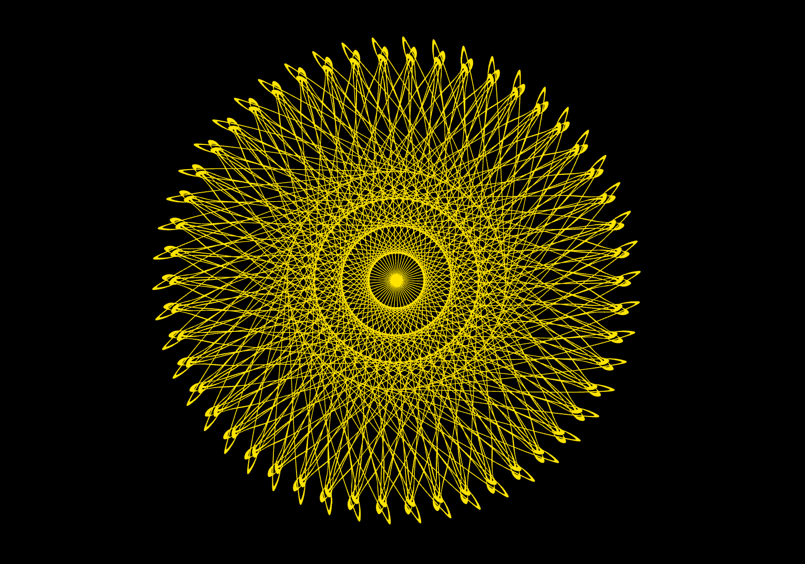

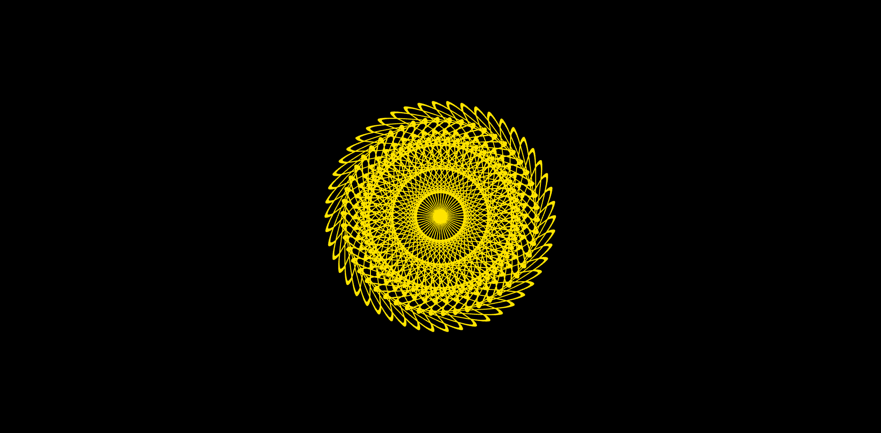
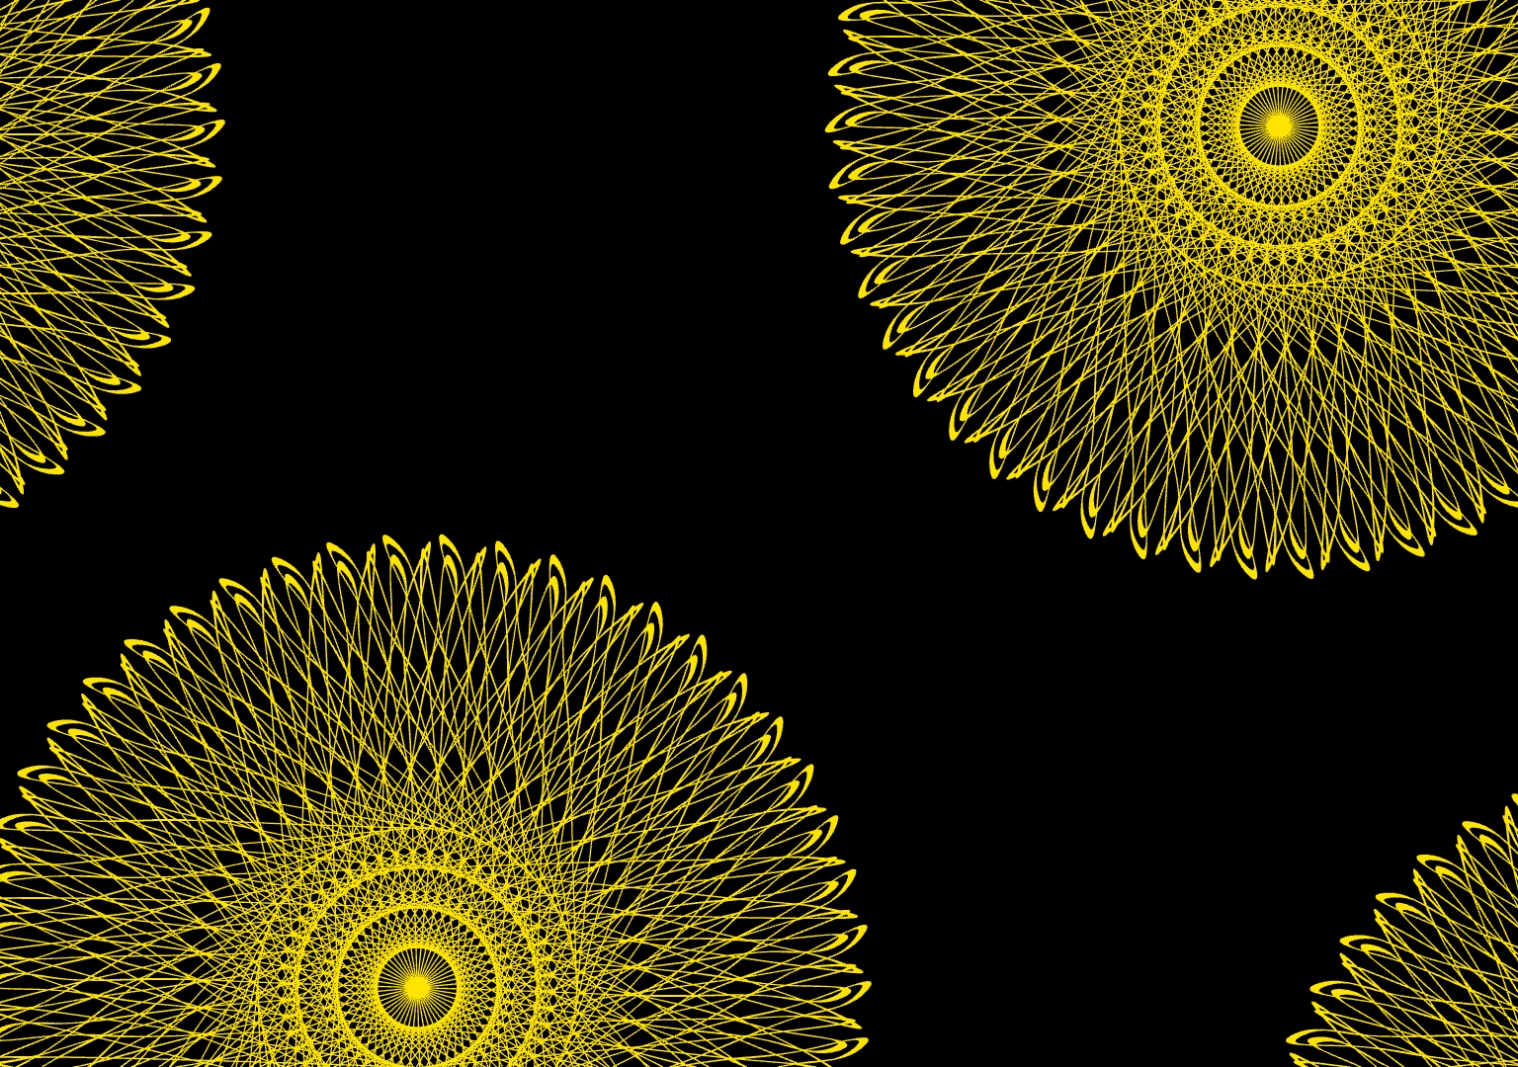
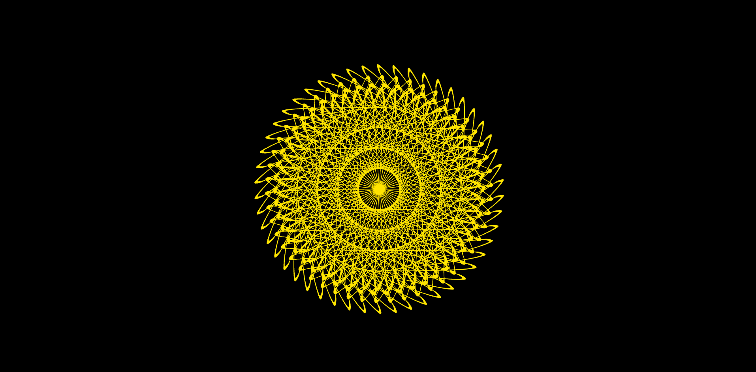
P3/7
<Computational Design Thinking>
<Generative Design>
P3/7
References
1/4
Youtube video of the blooming
https://youtu.be/57PC0VJWUy0
1/4
Captions
01 Blooming Stage 1
02 Blooming Stage 2
03 Blooming Stage 3
04 Blooming Stage 4
05 Fully Bloomed
06 Multiple
01
05
02
03
06
04

Slide 4
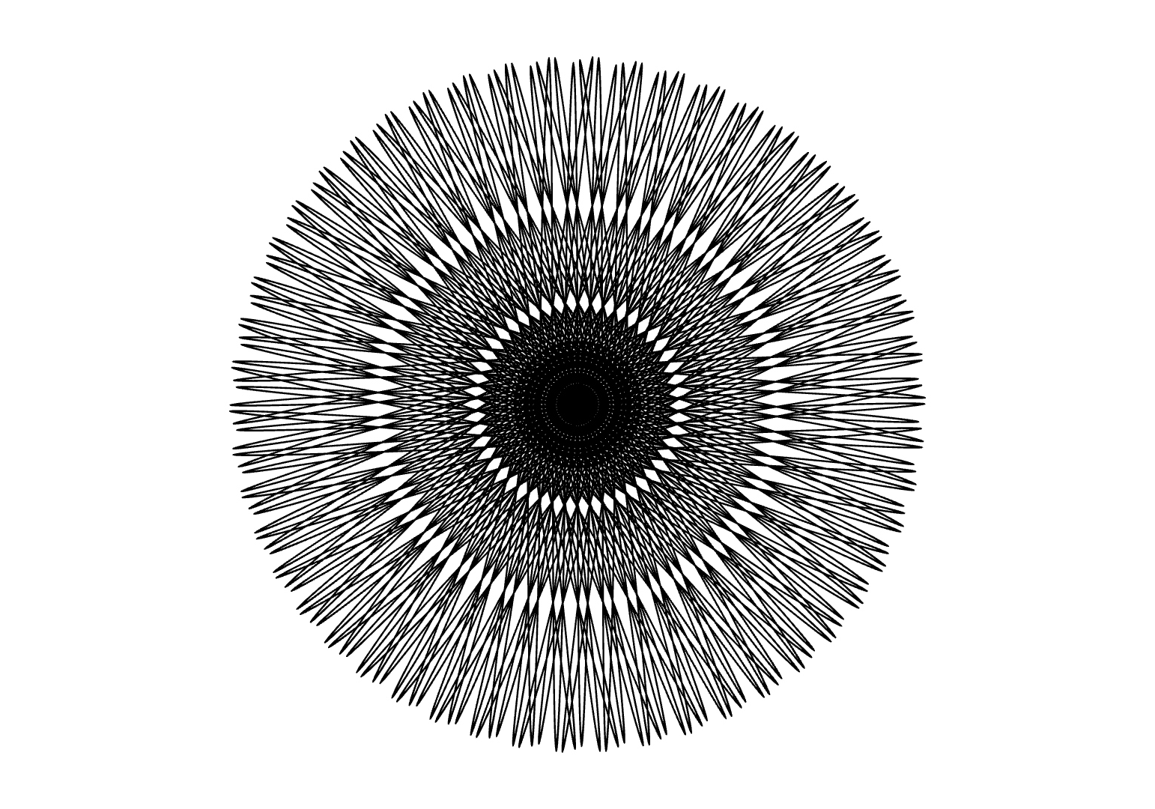
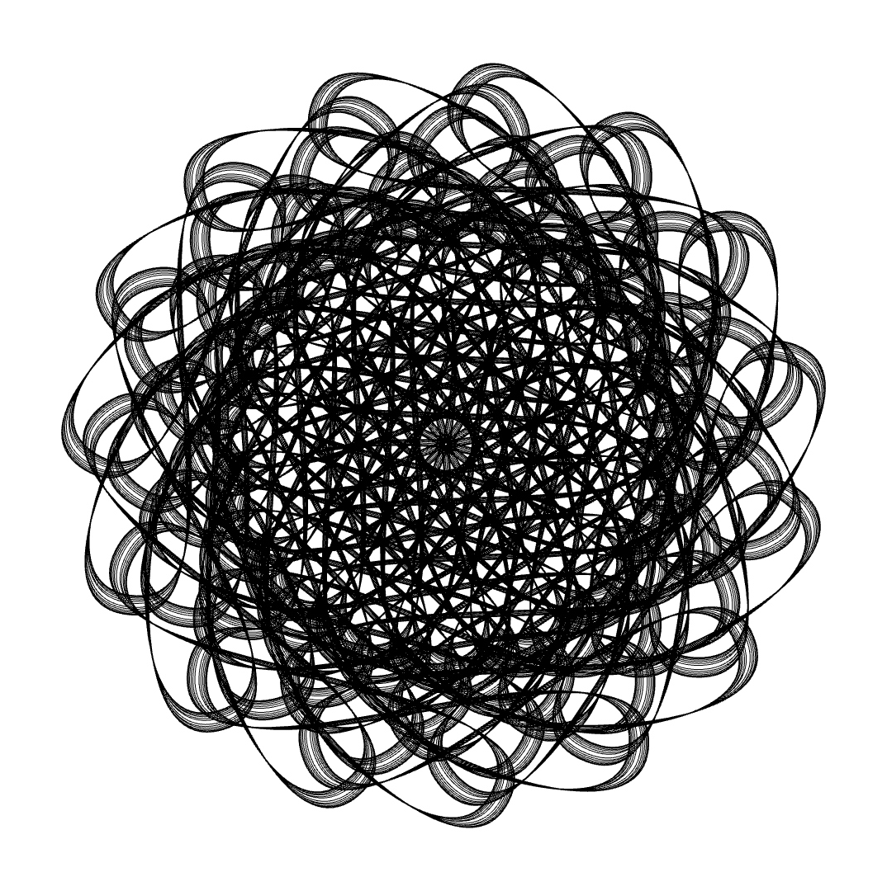
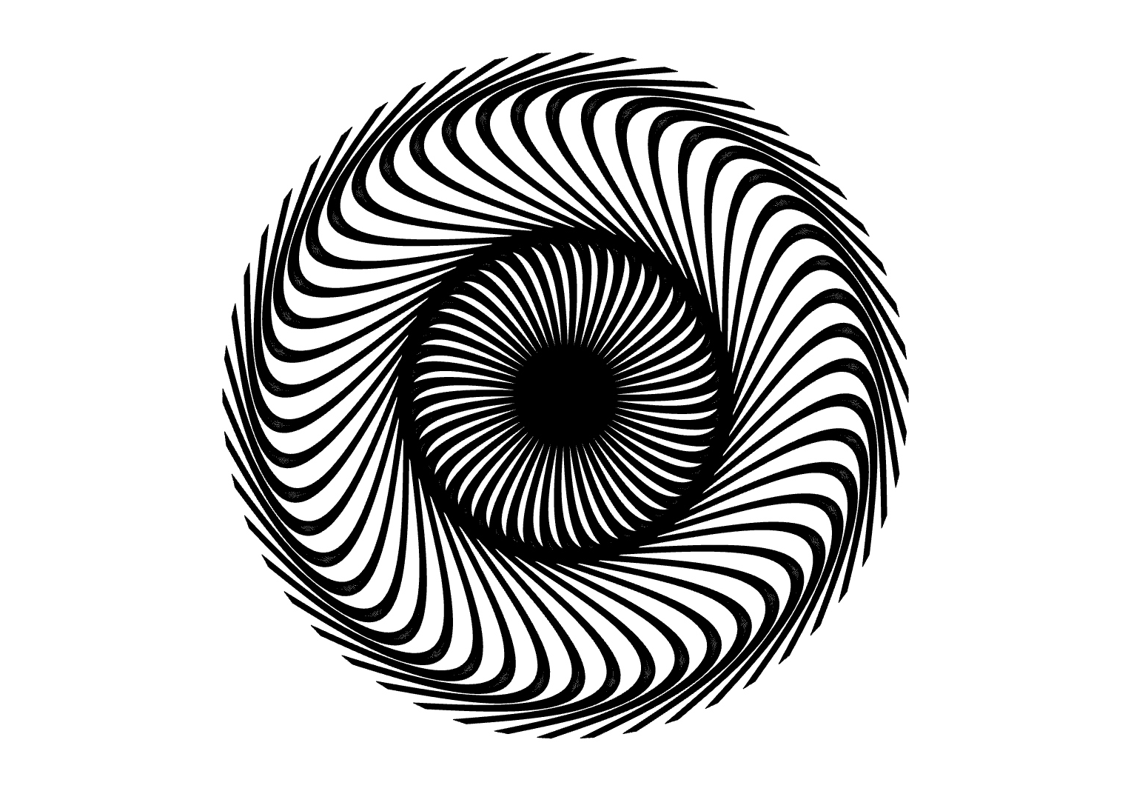
P4/7
<Computational Design Thinking>
<Generative Design>
P4/7
<Variations>
In the next 2 pages, experimentation with different designs and 2 different colors will be done.
<Black>
The general theme of the patterns on this page are ones that creates a sinister feeling.
By coloring the design black, it gives them a sort of chaotic feeling. Adding to that is also the spiral into a hyper-dense center, which makes it feels like it is sucking the viewer into it.
From one viewer perspective it might make them uncomfortable, but another might just find it hypnotically beautiful.
Captions
01 Twisted
02 Aggressive
03 Absorb
02
01
03

Slide 5
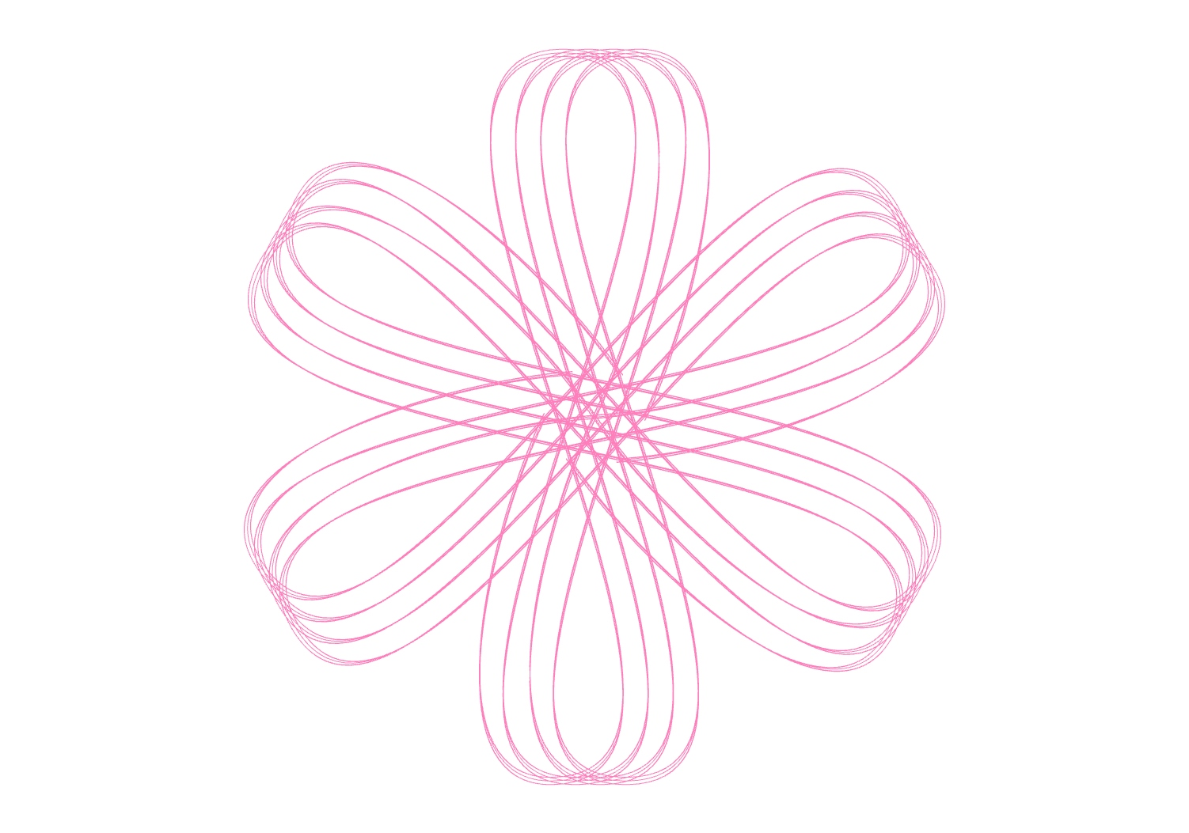
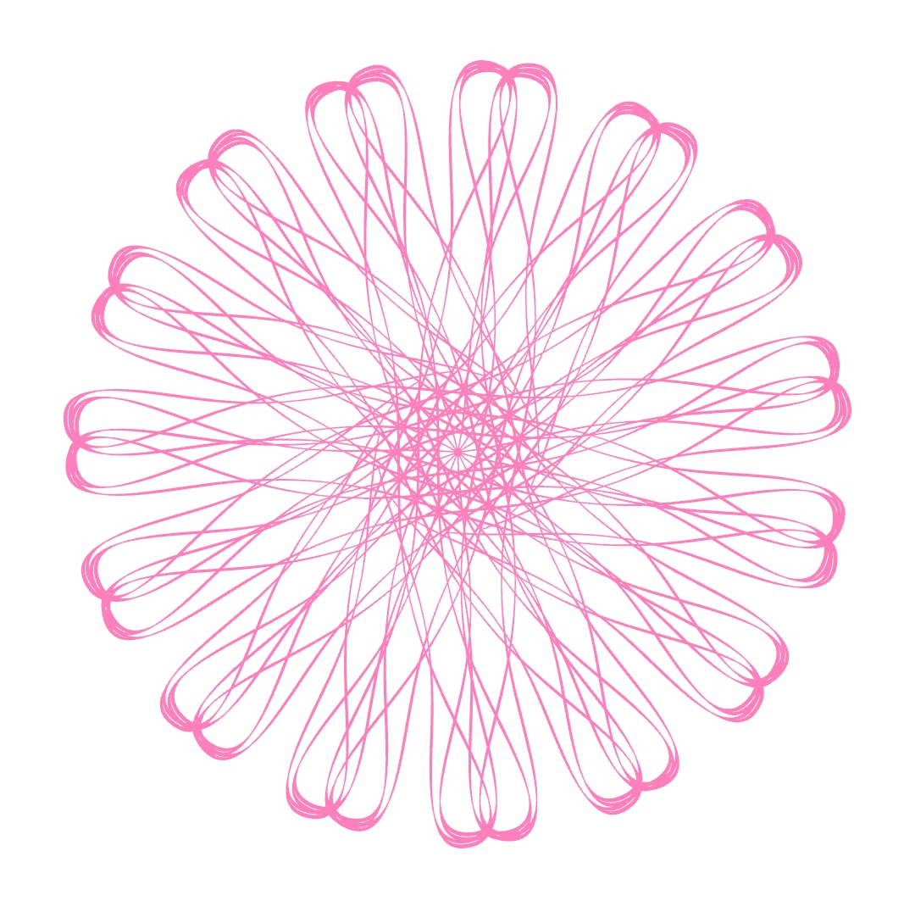
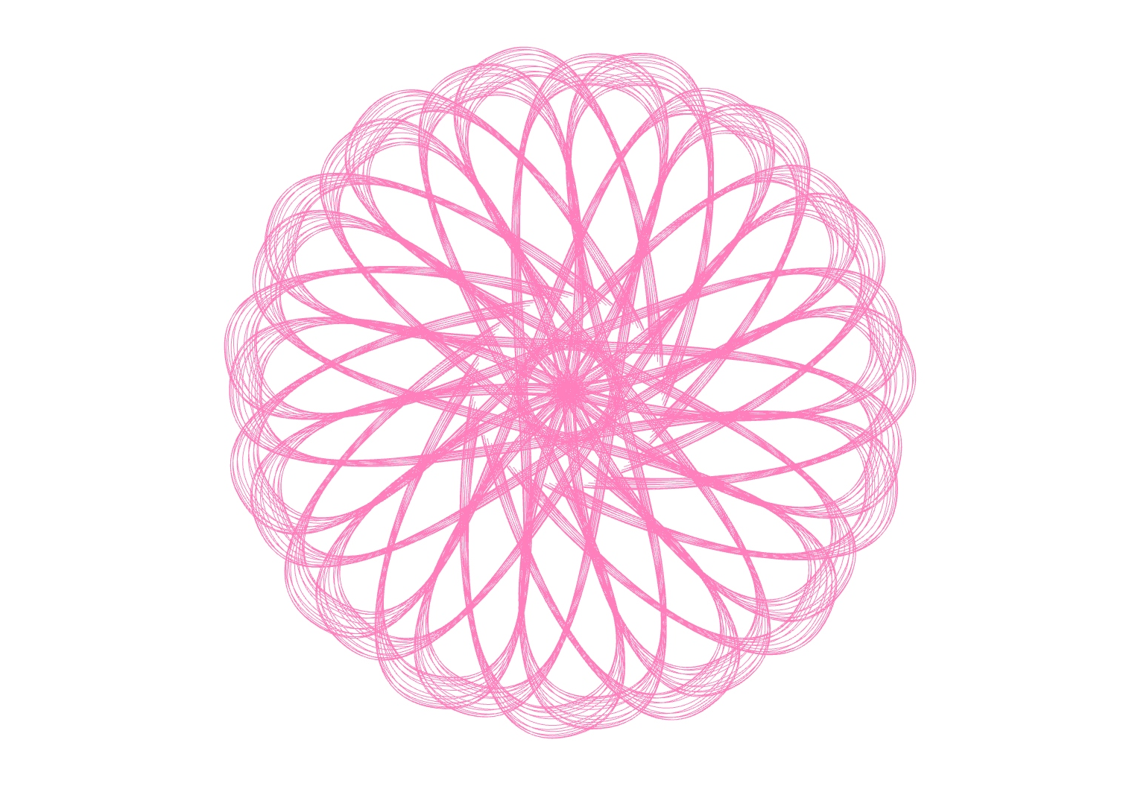
P5/7
<Computational Design Thinking>
<Generative Design>
P5/7
<Love>
To contrast it with the darker theme from the previous page, this exploration will focus more heartwarming designs colored in pink.
While at one end of the spectrum, using the same parameters can result in more aggressive looking designs, changing the same few parameters can also show more lovely designs like those shown.
Captions
01 Heart
02 Petals
03 Lotus Flower
02
01
03

Slide 6
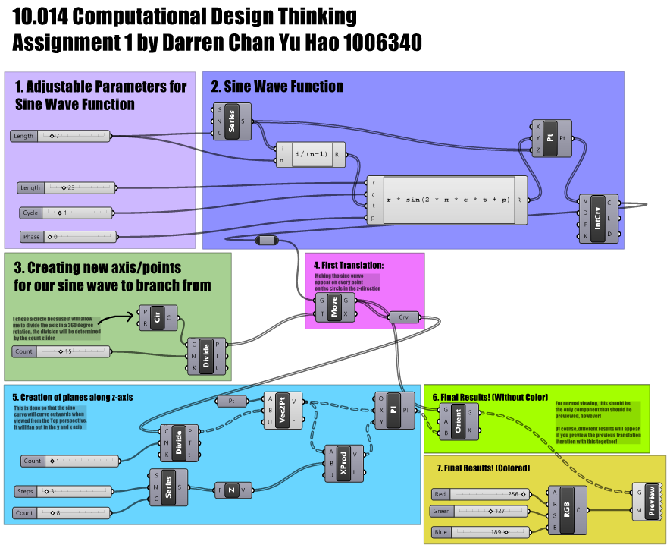
P6/7
<Computational Design Thinking>
<Generative Design>
P6/7
<Grasshopper>
The next few pages will touch on the steps taken to generate the designs shown.
It can be divided into 7 main steps:
Variable Sine Parameters
Sine Wave function
Creation of points for branching in 360 degree
Translating of Sine wave on to points
Creation of planes along Z-axis
Final design
Coloring
Captions
01 Overview of grasshopper chart
01

Slide 7
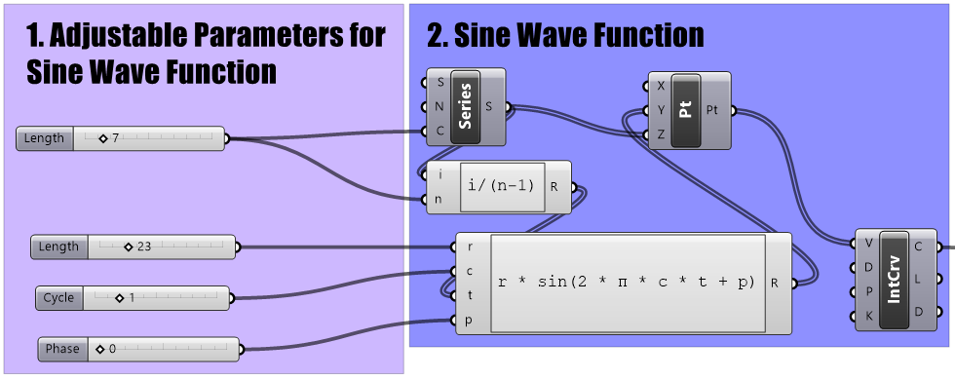
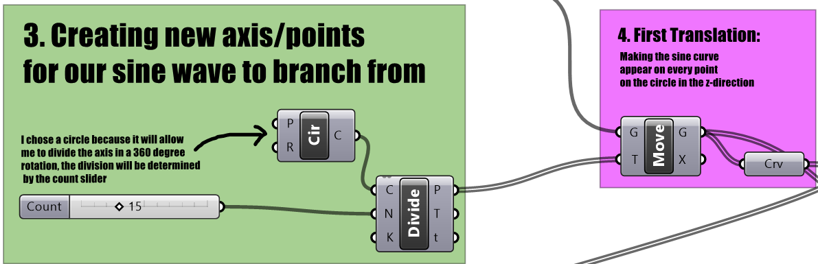
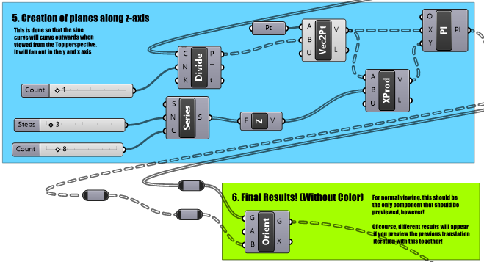
P7/7
<Computational Design Thinking>
<Generative Design>
P7/7
<1. Varying Sine Parameters>
The first step is to set your parameters for your sine wave which will be fed into the Sine wave function as shown
<2. Sine Wave Function>
The sine wave function is the core part of the program. It is the curve used to derive the designs. This curve, however, can ultimately be wave function. This expands the possible design infinitely.
<3. Creation of points for branching in 360 direction>
A circle divided into nth points is created to be used for the Sine waves to branch out from. This is done to create “thickness”.
<4. Translating of Sine wave on to points>
Doing this will result in sine waves on the previously mentioned points, running along the z-axis.
<5. Creation of planes along Z-axis>
The final step is the creation of planes on the points from step 3. These planes will be along the z-axis.
<6. Final design>
Finally, combine the sine curves with the planes and the designs shown in this project can be created.
<7. Coloring>
Coloring is also done to beautify the designs
1/4
1/4
1/2
Captions
01 Program Steps 1 and 2
02 Program Steps 3 and 4
03 Program Steps 5 and 6
01
02
03

